Slide 1
Chapter 6: Network Layer
Introduction to Networks
Notes:
Cisco Networking Academy program
Introduction to Networks
Chapter 6: Network Layer

Slide 2
Chapter 6: Objectives
In this chapter, you will be able to:
Explain how network layer protocols and services support communications across data networks.
Explain how routers enable end-to-end connectivity in a small-to-medium-sized business network.
Determine the appropriate device to route traffic in a small-to-medium-sized business network.
Configure a router with basic configurations.
Notes:
2
Chapter 6 Objectives

Slide 3
Chapter 6
6.1 Network Layer Protocols
6.2 Routing
6.3 Routers
6.4 Configuring a Cisco Router
6.5 Summary
Notes:
Chapter 6 Sections

Slide 4
6.1 Network Layer Protocols
Notes:
Cisco Networking Academy program
Introduction to Networks
Chapter 6: Network Layer

Slide 5
Network Layer in Communication The Network Layer
The network layer, or OSI Layer 3, provides services to allow end devices to exchange data across the network. To accomplish this end-to-end transport, the network layer uses four basic processes:
Addressing end devices
Encapsulation
Routing
De-encapsulating
Notes:
6.1.1.1 The Network Layer

Slide 6
Network Layer in Communication Network Layer Protocols
Common network layer protocols include:
IP version 4 (IPv4)
IP version 6 (IPv6)
Legacy network layer protocols include:
Novell Internetwork Packet Exchange (IPX)
AppleTalk
Connectionless Network Service (CLNS/DECNet)
Notes:
6.1.1.2 Network Layer Protocols

Slide 7
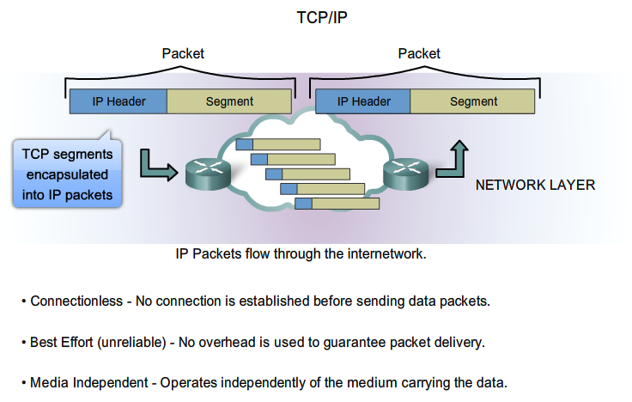
IP Characteristics IP Components
Notes:
6.1.2.1 Characteristics of IP

Slide 8
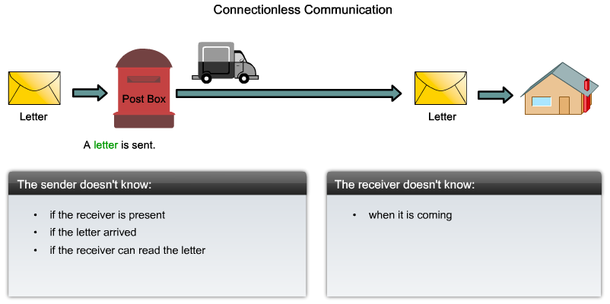
Characteristics of the IP protocol IP - Connectionless
Notes:
6.1.2.2 IP – Connectionless

Slide 9
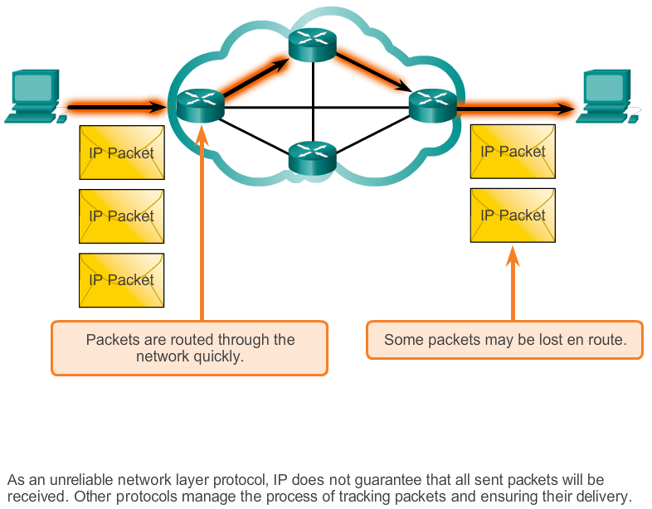
Characteristics of the IP protocol Best Effort Delivery
Notes:
6.1.2.3 IP – Best Effort Delivery

Slide 10
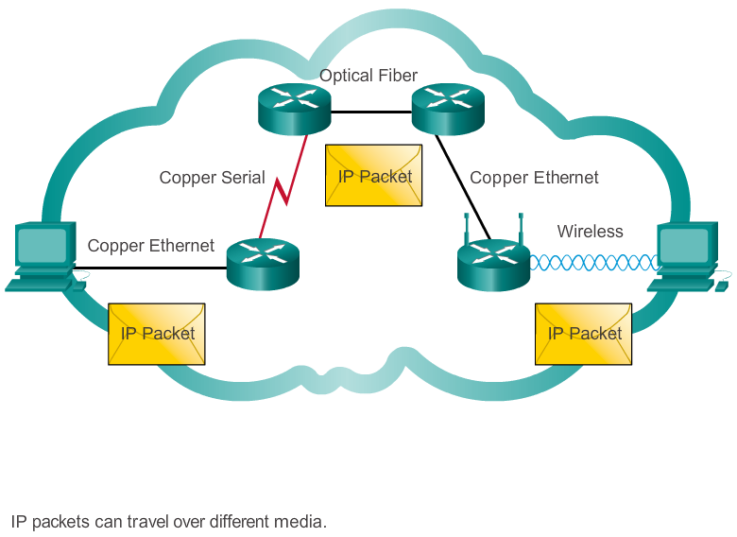
Characteristics of the IP protocol IP – Media Independent
Notes:
6.1.2.4 IP – Media Independent

Slide 11
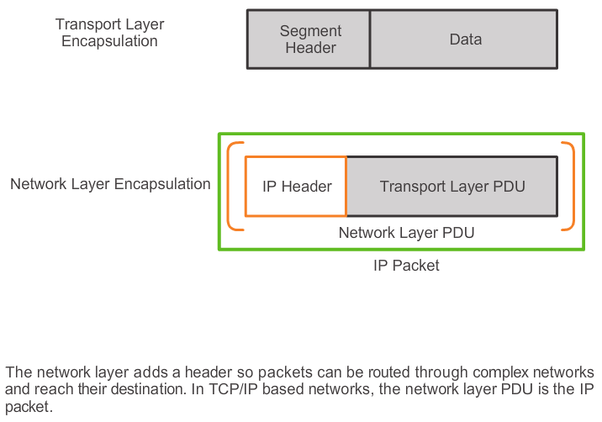
IPv4 Packet Encapsulating IP
Notes:
6.1.2.5 Encapsulating IP

Slide 12
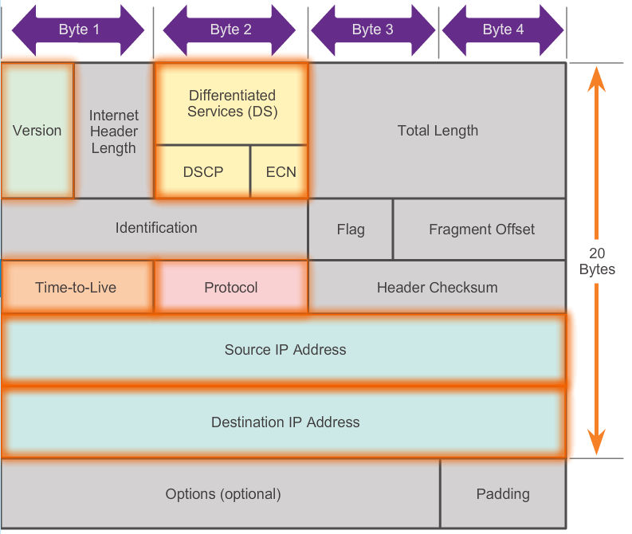
IPv4 Packet IPv4 Packet Header
Contents of the IPv4 packet header
Notes:
6.1.3.1 IPv4 Packet Header

Slide 13
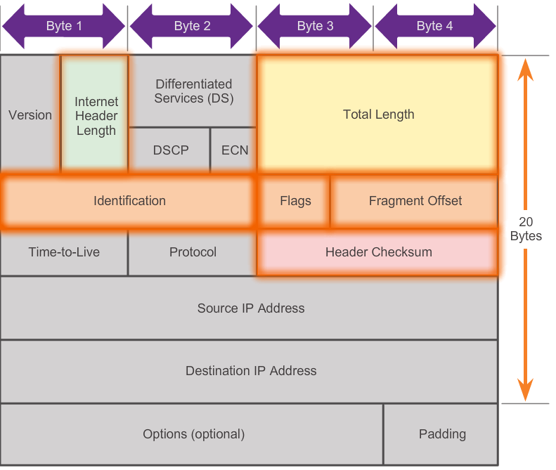
IPv4 Packet IPv4 Header Fields
Contents of the IPv4 header fields
Notes:
6.1.3.2 IPv4 Header Fields

Slide 14
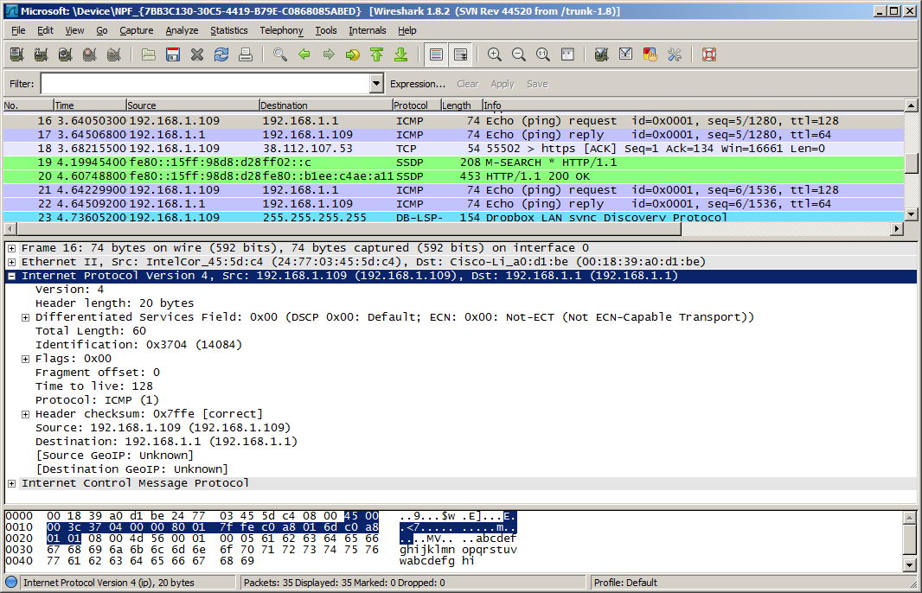
IPv4 Packet Sample IPv4 Headers
Notes:
6.1.3.3 Sample IPv4 Headers

Slide 15

Network Layer in Communication Limitations of IPv4
IP Address depletion
Internet routing table expansion
Lack of end-to-end connectivity
Notes:
6.1.4.1 Limitations of IPv4

Slide 16
Network Layer in Communication Introducing IPv6
Increased address space
Improved packet handling
Eliminates the need for NAT
Integrated security
4 billion IPv4 addresses 4,000,000,000
340 undecillion IPv6 addresses 340,000,000,000,000,000,000,000,000,000,000,000,000
Notes:
6.1.4.2 Introducing IPv6

Slide 17
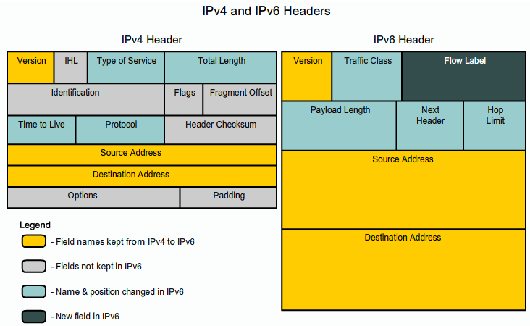
IPv6 Packet Encapsulating IPv6
Notes:
6.1.4.3 Encapsulating IPv6

Slide 18
IPv6 Packet IPv6 Packet Header
Byte 1
Byte 2
Byte 3
Byte 4
Version | Traffic Class |  | Flow Label
Payload Length |  |  |  | Next Header | Hop Limit
Source IP Address
Destination IP Address
Notes:
6.1.4.4 IPv6 Packet Header

Slide 19
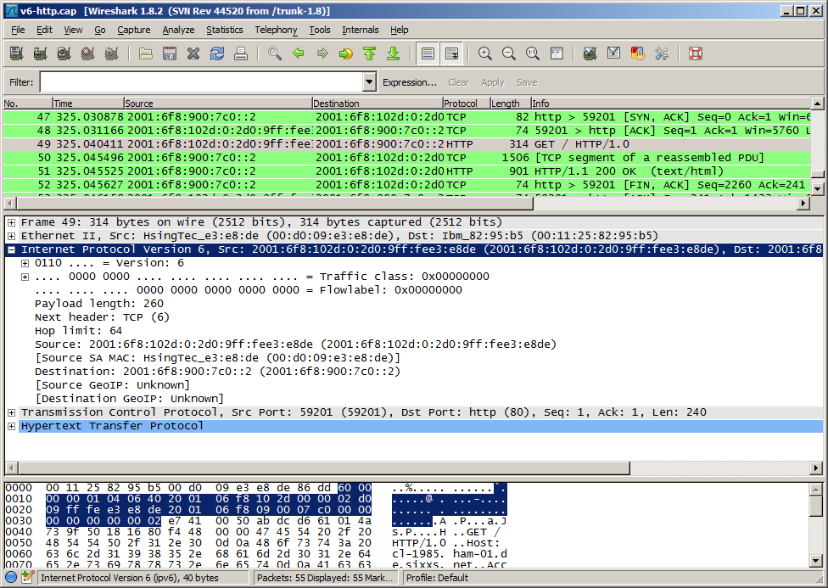
IPv6 Packet Sample IPv6 Header
Notes:
6.1.4.5 Sample IPv6 Header

Slide 20
6.2 Routing
Notes:
Cisco Networking Academy program
Introduction to Networks
Chapter 6: Network Layer

Slide 21
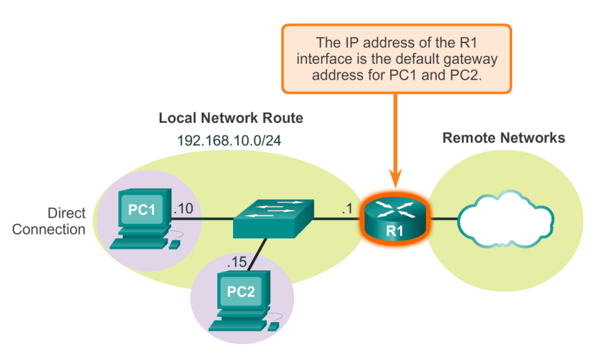
Host Routing Tables Host Packet Forwarding Decision
Notes:
6.2.1.1 Host Forwarding Decision

Slide 22
Host Routing Tables Default Gateway
Hosts must maintain their own, local, routing table to ensure that network layer packets are directed to the correct destination network. The local table of the host typically contains:
Direct connection
Local network route
Local default route
R
Notes:
6.2.1.2 Default Gateway

Slide 23
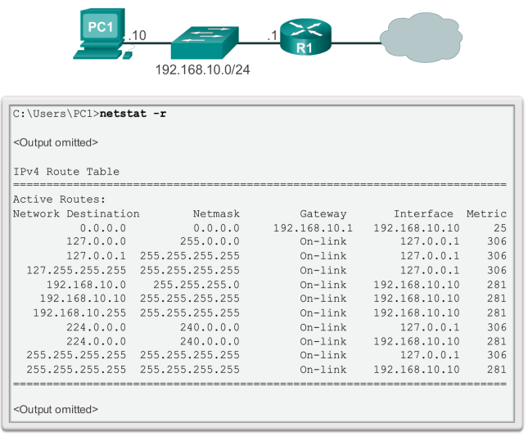
Host Routing Tables IPv4 Host Routing Table
Notes:
6.2.1.3 IPv4 Host Routing Table
6.2.1.4 IPv4 Host Routing Entries

Slide 24
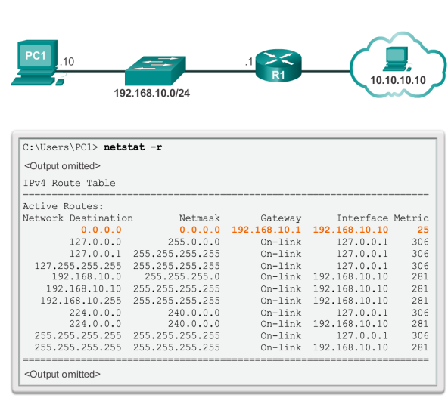
Host Routing Tables Sample IPv4 Host Routing Table
Notes:
6.2.1.5 Sample IPv4 Host Routing Table

Slide 25
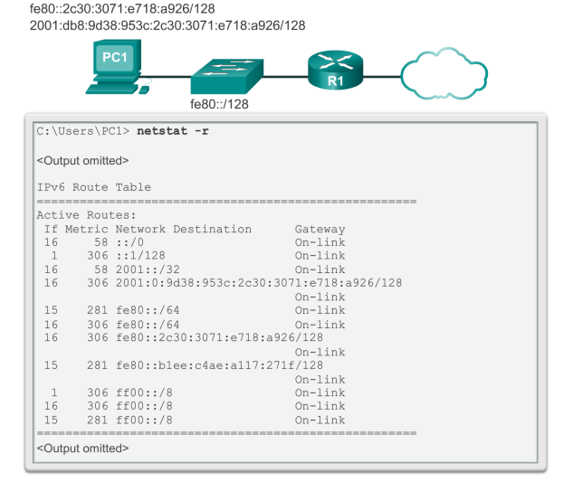
Host Routing Tables Sample IPv6 Host Routing Table
Notes:
6.2.1.6 Sample IPv6 Host Routing Table

Slide 26
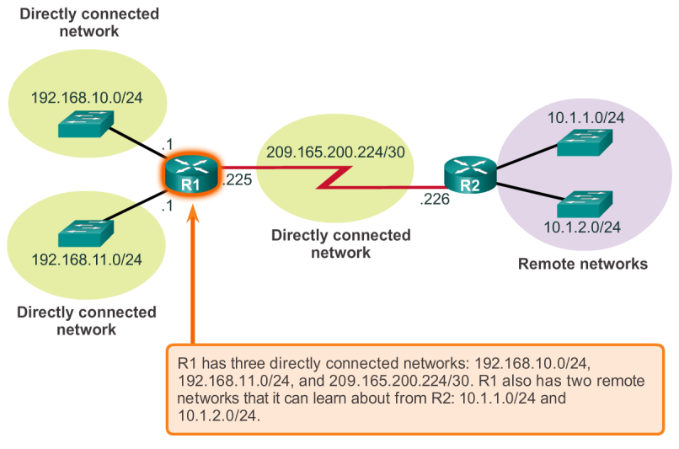
Router Routing Tables Router Packet Forwarding Decision
Notes:
6.2.2.1 Router Packet Forwarding Decision

Slide 27
Router Routing Tables IPv4 Router Routing Table
192.168.10.0/24
10.1.1.0/24
PC1
.10
G0/0
.1
209.165.200.224 /30
.10
.1
R1
.225
S0/0/0
.226
R2
.10
.1
G0/1
.1
.10
PC2
192.168.11.0/24
10.1.2.0/24
R1#show ip route
Codes: L - local, C - connected, S - static, R - RIP, M - mobile, B - BGP
D - EIGRP, EX - EIGRP external, O - OSPF, IA - OSPF inter area
N1 - OSPF NSSA external type 1, N2 - OSPF NSSA external type 2
E1 - OSPF external type 1, E2 - OSPF external type 2, E - EGP
i - IS-IS, L1 - IS-IS level-1, L2 - IS-IS level-2, ia - IS-IS inter area
* - candidate default, U - per-user static route, o - ODR
P - periodic downloaded static route
Gateway of last resort is not set
10.0.0.0/8 is variably subnetted, 2 subnets, 2 masks
D 10.1.1.0/24 [90/2170112] via 209.165.200.226, 00:00:05, Serial0/0/0
D 10.1.2.0/24 [90/2170112] via 209.165.200.226, 00:00:05, Serial0/0/0
192.168.10.0/24 is variably subnetted, 2 subnets, 3 masks
C 192.168.10.0/24 is directly connected, GigabitEthernet0/0
L 192.168.10.1/32 is directly connected, GigabitEthernet0/0
192.168.11.0/24 is variably subnetted, 2 subnets, 3 masks
C 192.168.11.0/24 is directly connected, GigabitEthernet0/1
L 192.168.11.1/32 is directly connected, GigabitEthernet0/1
209.165.200.0/24 is variably subnetted, 2 subnets, 3 masks
C 209.165.200.224/30 is directly connected, Serial0/0/0
L 209.165.200.225/32 is directly connected, Serial0/0/0
R1#
Notes:
6.2.2.2 IPv4 Router Routing Table

Slide 28
Router Routing Tables Directly Connected Routing Table Entries
192.168.10.0/24
64.100.0.1
10.1.1.0/24
PC1
.10
G0/0
.1
209.165.200.224 /30
.10
.1
R1
.225
S0/0/0
.226
R2
.10
.1
G0/1
.1
.10
PC2
192.168.11.0/24
10.1.2.0/24
A
B
C
C 192.168.10.0/24 is directly connected, GigabitEthernet0/0
L 192.168.10.1/32 is directly connected, GigabitEthernet0/0
A | Identifies how the network was learned by the router.
B | Identifies the destination network and how it is connected.
C | Identifies the interface on the router connected to the destination network.
Notes:
6.2.2.3 Directly Connected Routing Table Entries

Slide 29
Router Routing Tables Remote Network Routing Table Entries
192.168.10.0/24
64.100.0.1
10.1.1.0/24
PC1
.10
G0/0
.1
209.165.200.224 /30
.10
.1
R1
.225
S0/0/0
.226
R2
.10
.1
G0/1
.1
.10
PC2
192.168.11.0/24
10.1.2.0/24
D 10.1.1.0/24 [90/2170112] via 209.165.200.226, 00:00:05, Serial0/0/0
A | Identifies how the network was learned by the router.
B | Identifies the destination network.
C | Identifies the administrative distance (trustworthiness) of the route source.
D | Identifies the metric to reach the remote network.
E | Identifies the next hop IP address to reach the remote network.
F | Identifies the amount of elapsed time since the network was discovered.
G | Identifies the outgoing interface on the router to reach the destination network.
Notes:
6.2.2.4 Remote Network Routing Table Entries

Slide 30
Router Routing Tables Next-Hop Address
192.168.10.0/24
64.100.0.1
10.1.1.0/24
PC1
.10
G0/0
.1
209.165.200.224 /30
.10
.1
R1
.225
S0/0/0
.226
R2
.10
.1
G0/1
.1
.10
PC2
192.168.11.0/24
10.1.2.0/24
R1#show ip route
Codes: L - local, C - connected, S - static, R - RIP, M - mobile, B - BGP
D - EIGRP, EX - EIGRP external, O - OSPF, IA - OSPF inter area
N1 - OSPF NSSA external type 1, N2 - OSPF NSSA external type 2
E1 - OSPF external type 1, E2 - OSPF external type 2, E - EGP
i - IS-IS, L1 - IS-IS level-1, L2 - IS-IS level-2, ia - IS-IS inter area
* - candidate default, U - per-user static route, o - ODR
P - periodic downloaded static route
Gateway of last resort is not set
10.0.0.0/8 is variably subnetted, 2 subnets, 2 masks
D 10.1.1.0/24 [90/2170112] via 209.165.200.226, 00:00:05, Serial0/0/0
D 10.1.2.0/24 [90/2170112] via 209.165.200.226, 00:00:05, Serial0/0/0
192.168.10.0/24 is variably subnetted, 2 subnets, 3 masks
C 192.168.10.0/24 is directly connected, GigabitEthernet0/0
L 192.168.10.1/32 is directly connected, GigabitEthernet0/0
192.168.11.0/24 is variably subnetted, 2 subnets, 3 masks
C 192.168.11.0/24 is directly connected, GigabitEthernet0/1
L 192.168.11.1/32 is directly connected, GigabitEthernet0/1
209.165.200.0/24 is variably subnetted, 2 subnets, 3 masks
C 209.165.200.224/30 is directly connected, Serial0/0/0
L 209.165.200.225/32 is directly connected, Serial0/0/0
R1#
Notes:
6.2.2.5 Next-Hop Address

Slide 31
6.3 Routers
Notes:
Cisco Networking Academy program
Introduction to Networks
Chapter 6: Network Layer

Slide 32
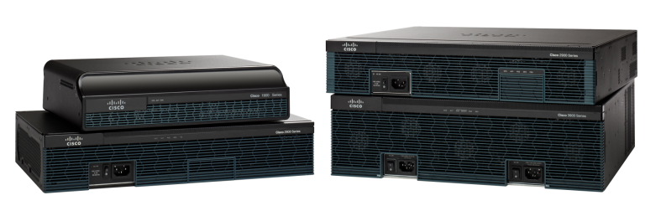
Anatomy of a Router A Router is a Computer
Notes:
6.3.1.1 A Router is a Computer

Slide 33
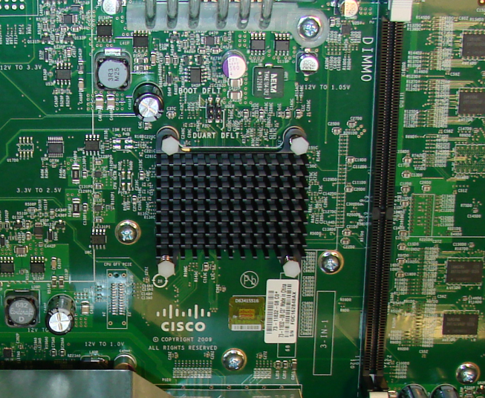
Anatomy of a Router Router CPU and OS
Notes:
6.3.1.2 Router CPU and OS

Slide 34
Anatomy of a Router Router Memory
Memory | Volatile / Non-Volatile | Stores
RAM | Volatile | Running IOS Running configuration file IP routing and ARP tables Packet buffer
ROM | Non-Volatile | Bootup instructions Basic diagnostic software Limited IOS
NVRAM | Non-Volatile | Startup configuration file
Flash | Non-Volatile | IOS Other system files
Notes:
6.3.1.3 Router Memory

Slide 35
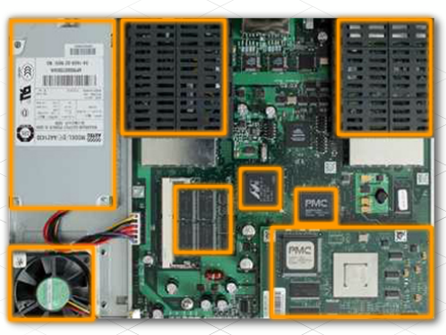
Anatomy of a Router Inside a Router
Power Supply
Shield for WIC
Fan
SDRAM
NVRAM
CPU
Advanced Integration Module (AIM)
1
2
2
5
4
6
7
3
Notes:
6.3.1.4 Inside a Router

Slide 36
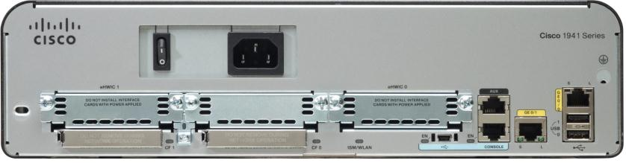
Anatomy of a Router Router Backplane
Double-Wide EHWIC slots
EHWIC 0
AUX
Port
LAN
Interfaces
Console RJ45
USB
Ports
Two 4 GB Flash Card Slots
Console
USB Type B
Notes:
6.3.1.5 Router Backplane

Slide 37
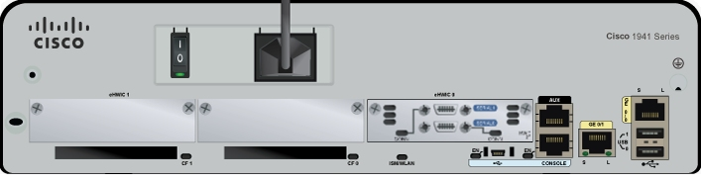
Anatomy of a Router Connecting to a Router
WAN
Interface
AUX
Port
LAN
Interfaces
Console RJ45
Console
USB Type B
Notes:
6.3.1.6 Connecting to a Router

Slide 38
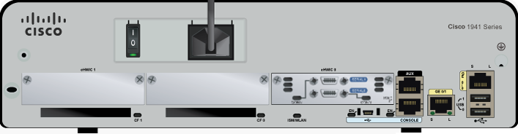
Anatomy of a Router LAN and WAN Interfaces
Serial Interfaces
LAN Interfaces
Notes:
6.3.1.7 LAN and WAN Interfaces

Slide 39
Router Boot-up Cisco IOS
The Cisco IOS operational details vary on different internetworking devices, depending on the device’s purpose and feature set. However, Cisco IOS for routers provides the following:
Addressing
Interfaces
Routing
Security
QoS
Resources Management
Notes:
6.3.2.1 Cisco IOS

Slide 40
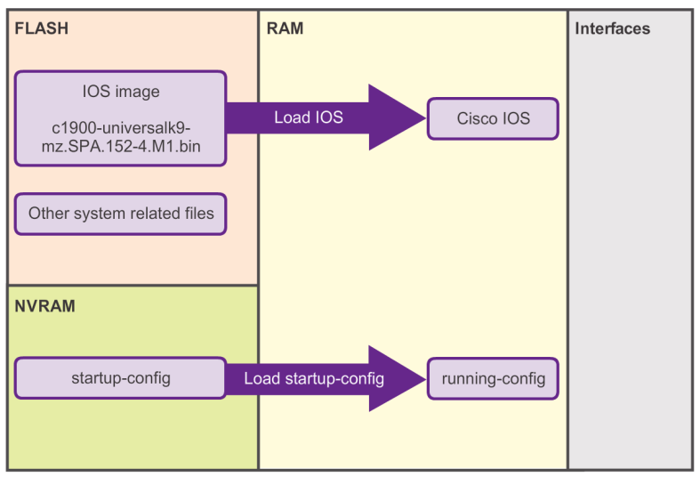
Router Boot-up Bootset Files
Notes:
6.3.2.2 Bootset Files

Slide 41
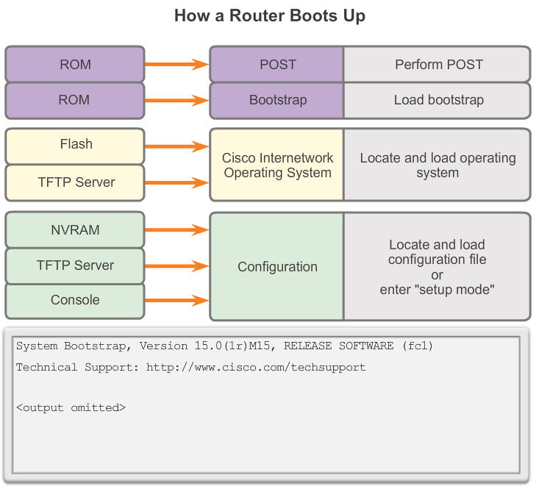
Router Boot-up Router Bootup Process
Notes:
6.3.2.3 Router Bootup Process

Slide 42
Router Boot-up Show Versions Output
Router# show version
Cisco IOS Software, C1900 Software (C1900-UNIVERSALK9-M), Version 15.2(4)M1, RELEASE SOFTWARE (fc1)
Technical Support: http://www.cisco.com/techsupport
Copyright (c) 1986-2012 by Cisco Systems, Inc.
Compiled Thu 26-Jul-12 19:34 by prod_rel_team
ROM: System Bootstrap, Version 15.0(1r)M15, RELEASE SOFTWARE (fc1)
Router uptime is 10 hours, 9 minutes
System returned to ROM by power-on
System image file is "flash0:c1900-universalk9-mz.SPA.152-4.M1.bin"
Last reload type: Normal Reload
Last reload reason: power-on
<Output omitted>
Cisco CISCO1941/K9 (revision 1.0) with 446464K/77824K bytes of memory.
Processor board ID FTX1636848Z
2 Gigabit Ethernet interfaces
2 Serial(sync/async) interfaces
1 terminal line
DRAM configuration is 64 bits wide with parity disabled.
255K bytes of non-volatile configuration memory.
250880K bytes of ATA System CompactFlash 0 (Read/Write)
<Output omitted>
Technology Package License Information for Module:'c1900'
-----------------------------------------------------------------
Technology Technology-package Technology-package
Current Type Next reboot
------------------------------------------------------------------
ipbase ipbasek9 Permanent ipbasek9
security None None None
data None None None
Configuration register is 0x2142 (will be 0x2102 at next reload)
Router#
Notes:
6.3.2.4 Show Version Output

Slide 43
6.4 Configuring a Cisco Router
Notes:
Cisco Networking Academy program
Introduction to Networks
Chapter 6: Network Layer

Slide 44
Configure Initial Settings Router Configuration Steps
192.168.10.0/24
10.1.1.0/24
PC1
.10
G0/0
.1
209.165.200.224 /30
.10
.1
R1
.225
S0/0/0
.226
R2
.10
.1
G0/1
.1
.10
PC2
192.168.11.0/24
10.1.2.0/24
Router> enable
Router# configure terminal
Enter configuration commands, one per line. End with CNTL/Z.
Router(config)# hostname R1
R1(config)#
Router> en
Router# conf t
Enter configuration commands, one per line. End with CNTL/Z.
Router(config)# ho R1
R2(config)#
OR
R1(config)# enable secret class
R1(config)#
R1(config)# line console 0
R1(config-line)# password cisco
R1(config-line)# login
R1(config-line)# exit
R1(config)#
R1(config)# line vty 0 4
R1(config-line)# password cisco
R1(config-line)# login
R1(config-line)# exit
R1(config)#
R1(config)# service password-encryption
R1(config)#
R1(config)# banner motd #
Enter TEXT message. End with the character '#'.
***********************************************
WARNING: Unauthorized access is prohibited!
***********************************************
#
R1(config)#
R1# copy running-config startup-config
Destination filename [startup-config]?
Building configuration...
[OK]
R1#
Notes:
6.4.1.1 Router Configuration Steps

Slide 45
Configure Interfaces Configure LAN Interfaces
192.168.10.0/24
10.1.1.0/24
PC1
.10
G0/0
.1
209.165.200.224 /30
.10
.1
R1
.225
S0/0/0
.226
R2
.10
.1
G0/1
.1
.10
PC2
192.168.11.0/24
10.1.2.0/24
R1# conf t
Enter configuration commands, one per line. End with CNTL/Z.
R1(config)#
R1(config)# interface gigabitethernet 0/0
R1(config-if)# ip address 192.168.10.1 255.255.255.0
R1(config-if)# description Link to LAN-10
R1(config-if)# no shutdown
%LINK-5-CHANGED: Interface GigabitEthernet0/0, changed state to up
%LINEPROTO-5-UPDOWN: Line protocol on Interface GigabitEthernet0/0, changed state to up
R1(config-if)# exit
R1(config)#
R1(config)# int g0/1
R1(config-if)# ip add 192.168.11.1 255.255.255.0
R1(config-if)# des Link to LAN-11
R1(config-if)# no shut
%LINK-5-CHANGED: Interface GigabitEthernet0/1, changed state to up
%LINEPROTO-5-UPDOWN: Line protocol on Interface GigabitEthernet0/1, changed state to up
R1(config-if)# exit
R1(config)#
Notes:
6.4.2.1 Configure LAN Interfaces

Slide 46
Configure Interfaces Verify Interface Configuration
192.168.10.0/24
10.1.1.0/24
PC1
.10
G0/0
.1
209.165.200.224 /30
.10
.1
R1
.225
S0/0/0
.226
R2
.10
.1
G0/1
.1
.10
PC2
192.168.11.0/24
10.1.2.0/24
R1# show ip interface brief
Interface IP-Address OK? Method Status Protocol
GigabitEthernet0/0 192.168.10.1 YES manual up up
GigabitEthernet0/1 192.168.11.1 YES manual up up
Serial0/0/0 209.165.200.225 YES manual up up
Serial0/0/1 unassigned YES NVRAM administratively down down
Vlan1 unassigned YES NVRAM administratively down down
R1#
R1# ping 209.165.200.226
Type escape sequence to abort.
Sending 5, 100-byte ICMP Echos to 209.165.200.226, timeout is 2 seconds:
!!!!!
Success rate is 100 percent (5/5), round-trip min/avg/max = 1/2/9 ms
R1#
Notes:
6.4.2.2 Verify Interface Configuration

Slide 47
Configuring the Default Gateway Default Gateway on a Host
Default Gateway not needed
PC1
.10
192.168.10.0/24
.1
G0/0
Default Gateway needed
PC2
.10
R1
G0/1
.1
PC1
.10
192.168.10.0/24
.1
G0/0
.10
PC2
.11
PC3
R1
.10
192.168.11.0/24
G0/1
.1
PC4
PC3
.10
.11
192.168.11.0/24
PC4
Notes:
6.4.3.1 Default Gateway on a Host

Slide 48
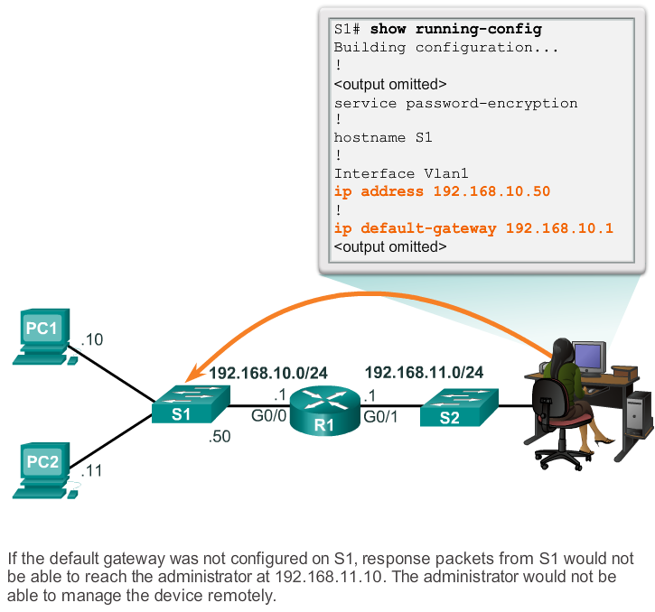
Configuring the Default Gateway Default Gateway on a Switch
Notes:
6.4.3.2 Default Gateway on a Switch

Slide 49
Network Layer Summary
In this chapter, you learned:
The network layer, or OSI Layer 3, provides services to allow end devices to exchange data across the network.
The network layer uses four basic processes: IP addressing for end devices, encapsulation, routing, and de-encapsulation.
The Internet is largely based on IPv4, which is still the most widely-used network layer protocol.
An IPv4 packet contains the IP header and the payload.
The IPv6 simplified header offers several advantages over IPv4, including better routing efficiency, simplified extension headers, and capability for per-flow processing.
Notes:
Chapter 6 Summary

Slide 50
Network Layer Summary (cont.)
In addition to hierarchical addressing, the network layer is also responsible for routing.
Hosts require a local routing table to ensure that packets are directed to the correct destination network.
The local default route is the route to the default gateway.
The default gateway is the IP address of a router interface connected to the local network.
When a router, such as the default gateway, receives a packet, it examines the destination IP address to determine the destination network.
Notes:
Chapter 6 Summary (cont.)

Slide 51
Network Layer Summary (cont.)
The routing table of a router stores information about directly-connected routes and remote routes to IP networks. If the router has an entry in its routing table for the destination network, the router forwards the packet. If no routing entry exists, the router may forward the packet to its own default route, if one is configured or it will drop the packet.
Routing table entries can be configured manually on each router to provide static routing or the routers may communicate route information dynamically between each other using a routing protocol.
For routers to be reachable, the router interface must be configured.
Notes:
Chapter 6 Summary (cont.)

Slide 52


